Slide 1




AJ DEEPCHECK
Image Deepfake detection and fact checking
Oussama Safi
Yousif Yousif
Emran Altamimi
Hamza Nabeel
Ahmed Shahid

Slide 2




Agenda
Problem
Workflow
Solution overview
Components
System Architecture
Demo

Slide 3
Problem Statement
1 in 3 social media images could be AI-generated by 2025 (MIT Tech Review).
Deepfakes fuel misinformation, fraud, and reputational damage.
Current tools are slow, expensive, or inaccessible to most users.

Slide 4
Solution Overview
A fast, explainable web app that:
Detects Deepfakes using AI models.
Performs fact checking using reverse image search.
Explains results in plain language with confidence scores.

Slide 5

System Architecture
User Interface (Frontend)
AI Pipeline
● Upload media (images)
● Real-time processing status
● Explainable results with confidence scores
●Detection of AI generated images
● Detection of Deepfake
● Reverse image search
● LLM reasoning model
Backend (FastAPI)
Infrastructure (Huawei Cloud)
● Preprocess media (frame extraction, metadata analysis)
● Orchestrate AI pipelines via LangChain
● ECS: Cloud VMs
● OBS (Object Storage Service) for media

Slide 6
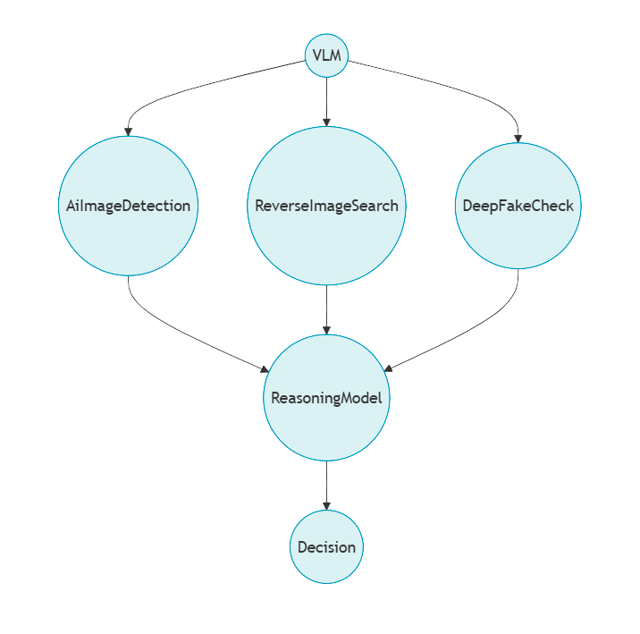

Slide 7
Components
This system integrates two key functions for detecting manipulated images:
AI-Generated Content Detection:
Determines whether an image was created by AI (e.g., DALL·E, Midjourney).
Returns a likelihood score (0.0 to 1.0) indicating how likely the image is AI-generated.
Based on SightEngine’s `genai` model.
Deepfake Detection:
Checks if a face in an image is a deepfake (digitally altered or synthetic).
Returns a likelihood score (0.0 to 1.0) for deepfake probability.
Based on SightEngine’s `deepfake` model.

Slide 8
Reverse Image Search
This system performs a reverse image search using Google Lens via SerpAPI, extracts matching images, and retrieves text content from the top results.
Finds visually similar images across the web.
Retrieves text content from the top matching pages for context.
Helps verify image authenticity, track sources, or detect plagiarism.

Slide 9
Demo

Slide 10
Future work and Improvements
Video Detection
Browser extention implementation

Slide 11
Thankyou!
Questions?

